Slide 1
Mini-Project Election Results Prediction by analyzing Tweets Dataset
Subject: Natural Language Processing(NLP)

Slide 2
Group Members:
1. Bhosale Bhushan Sunil 408
2. Kunjir Shubham Ganesh 457
3. Markad Prajakta Dhananjay 460
4. Salvi Neha Lilachand 478
Guide:
Prof. V.G. Jagtap
Subject: Natural Language Processing(NLP)

Slide 3
Table of contents
01
02
03
04
Problem Statement
Objectives
System Architecture
Implementation and Results
05
Conclusion

Slide 4
01
Problem Statement
(NLP)

Slide 5
Problem Statement
The problem addressed in the Election Results Prediction project is the need to predict election outcomes by analyzing tweets dataset using Natural Language Processing (NLP) techniques. With the rise of social media platforms and their significant impact on public opinion, there is a growing demand for real-time insights into public sentiment and the ability to gauge the popularity of political candidates. However, the vast amount of user-generated content on platforms like Twitter poses a challenge in efficiently extracting meaningful insights and accurately predicting election results.

Slide 6
02
Objectives
(NLP)

Slide 7
Objectives
The main objectives of this project are as follows:
Collect a large dataset of tweets related to the election.
Pre-process the dataset by removing noise, handling text normalization, and feature extraction.
Train a machine learning model using the pre-processed data to classify tweets into sentiment categories (positive, negative, neutral).
Analyze the classified tweets to understand public sentiment towards candidates.
Utilize the sentiment analysis results to predict election outcomes.

Slide 8
03
System Architecture
(NLP)

Slide 9
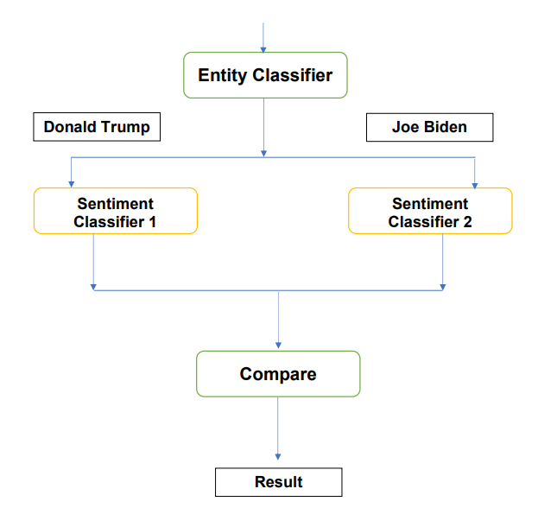

Slide 10
04
Implementation & Results
(NLP)

Slide 11
Software Requirement
Operating System : Windows 10
IDE : Jupyter Notebook or any python IDE
Programming Language : Python

Slide 12
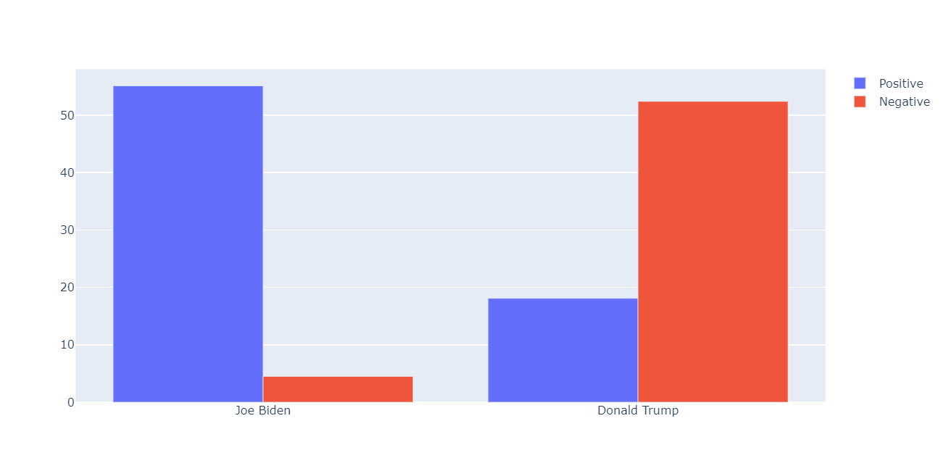
Results

Slide 13
05
Conclusion
(NLP)

Slide 14
Conclusion
In conclusion, this project aims to predict election results by analyzing tweets dataset using NLP techniques and machine learning algorithms. By harnessing the power of NLP and sentiment analysis, we can gain valuable insights into public sentiment and utilize that information for predicting election outcomes. The successful implementation of this project can contribute to the field of political analysis and assist in making informed decisions based on real-time social media data

Slide 15
Thank You!

